Slide 1
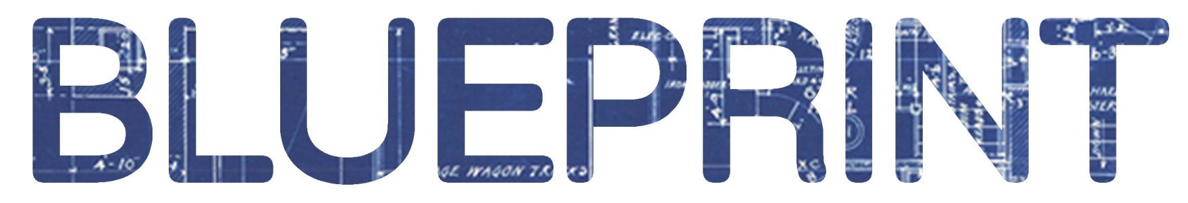

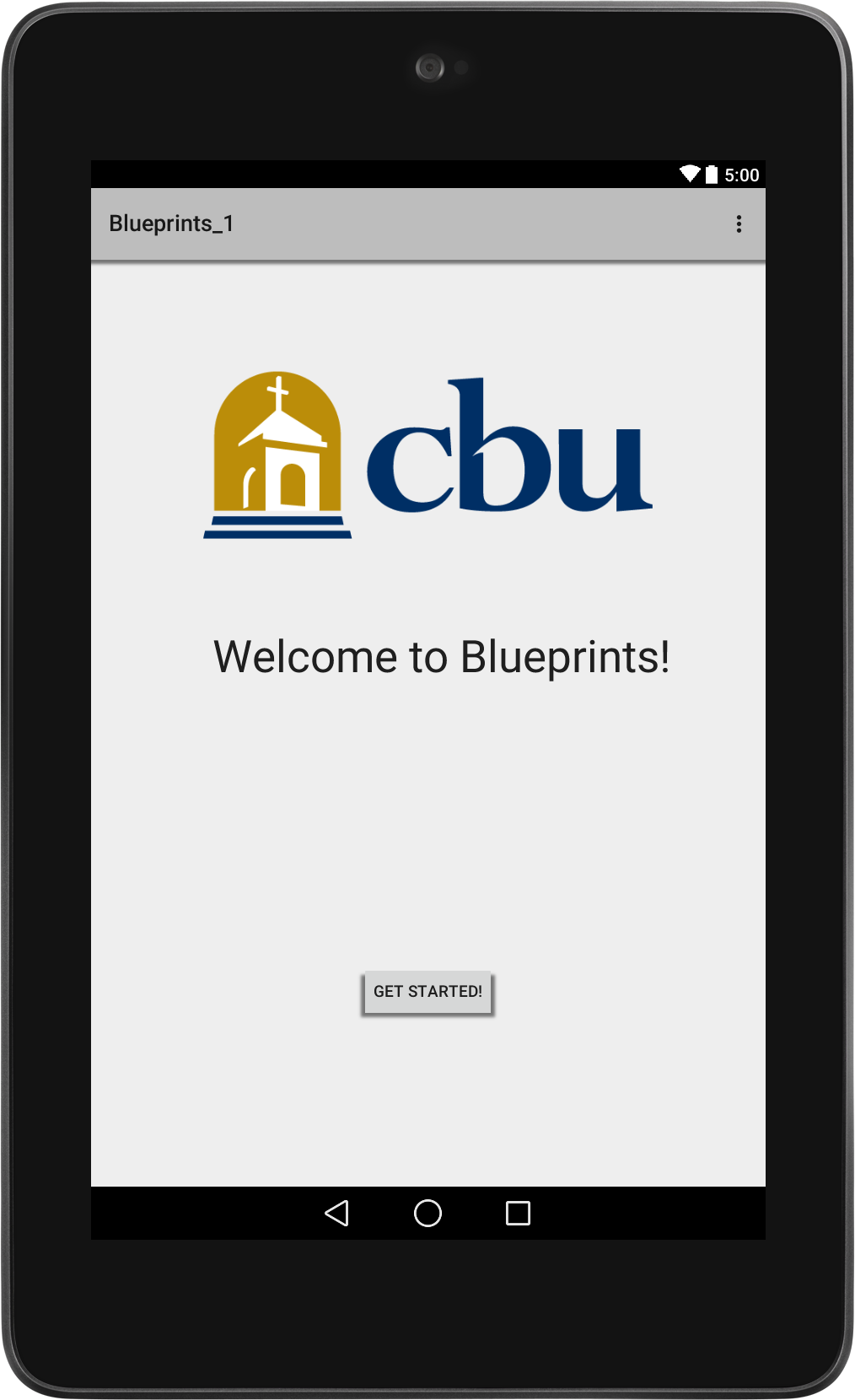

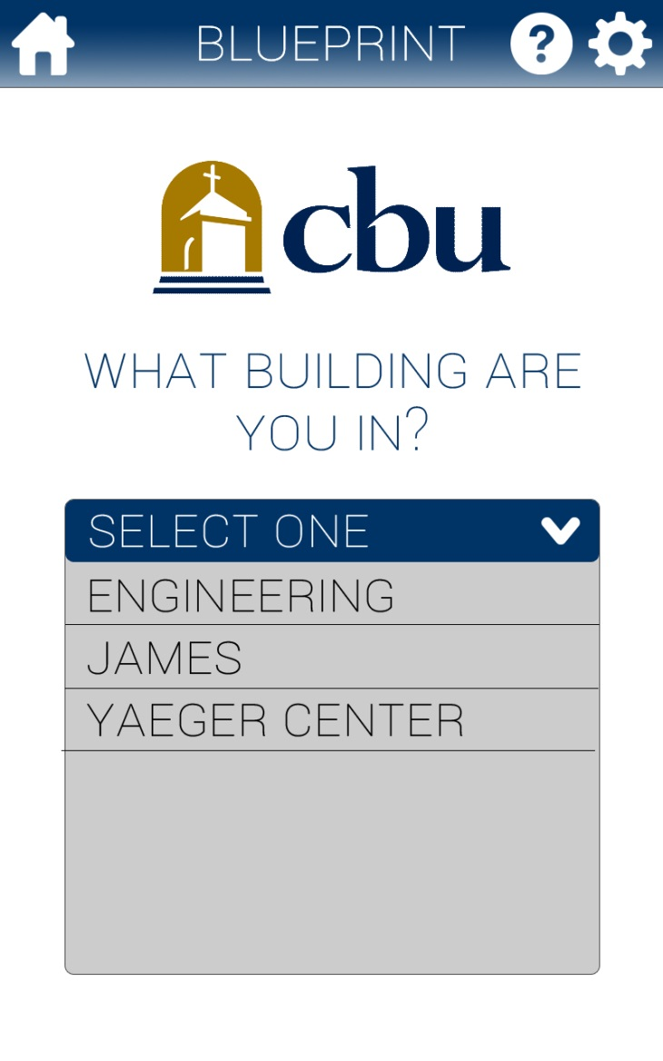
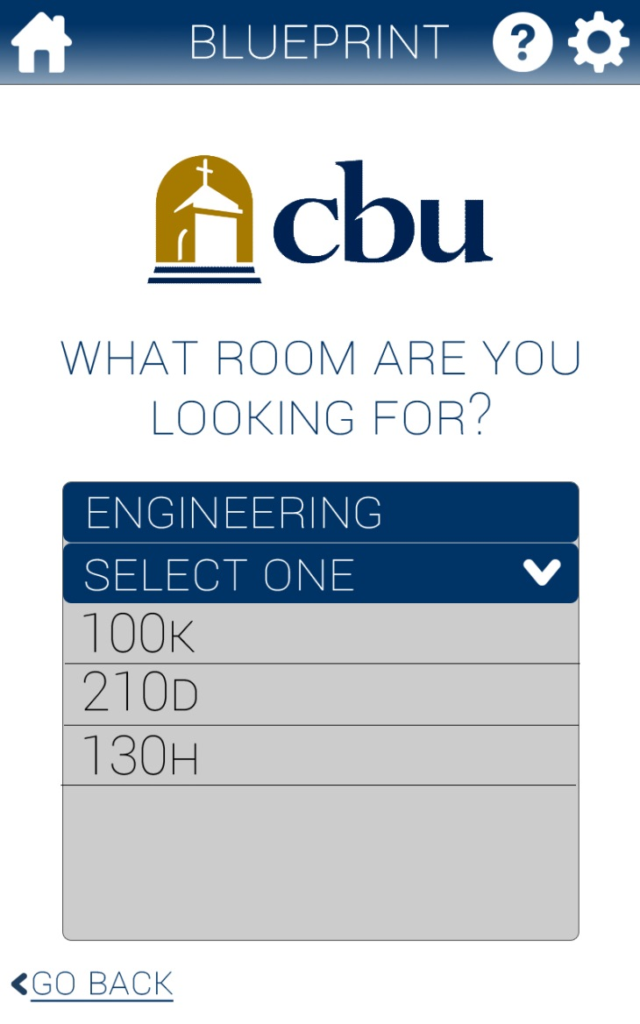
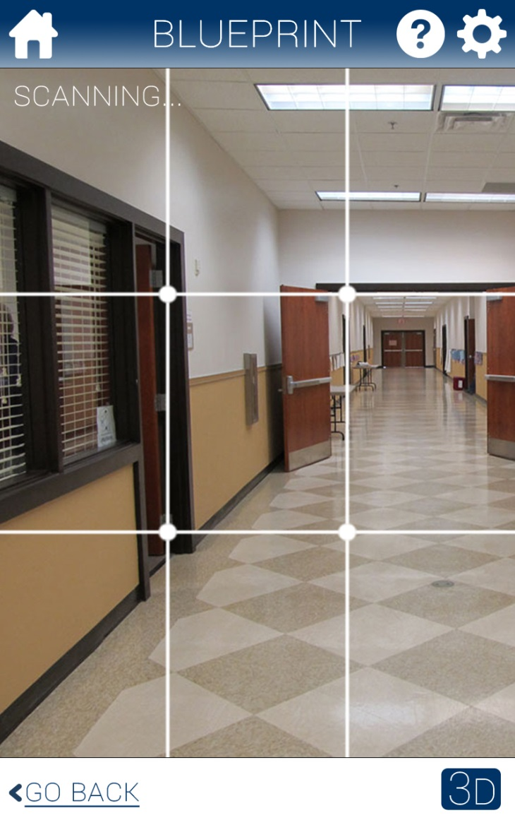
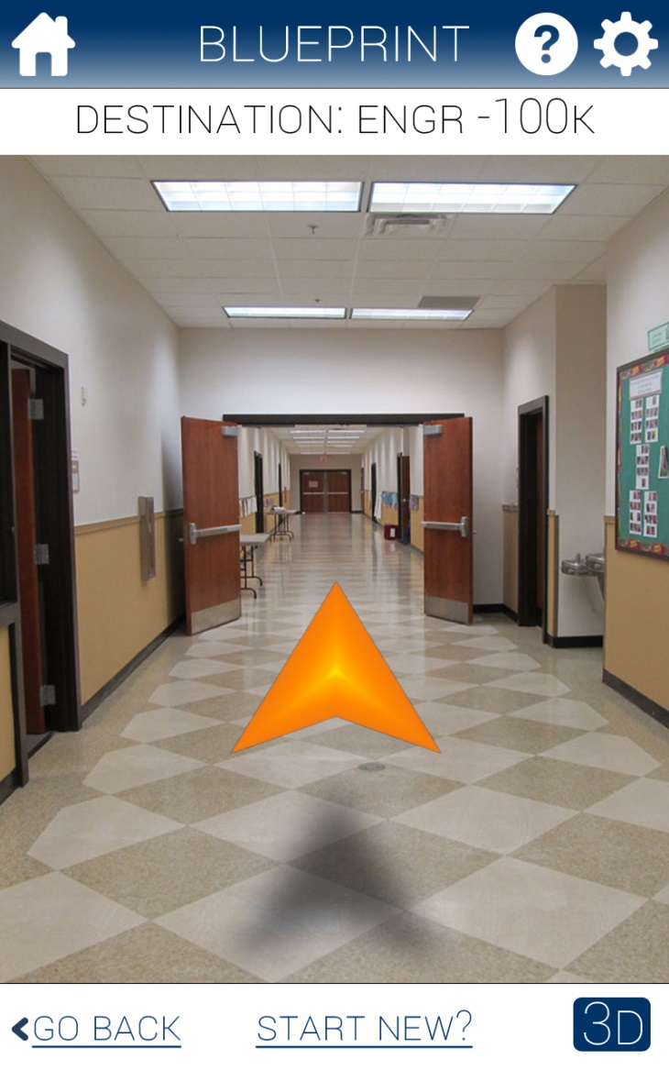
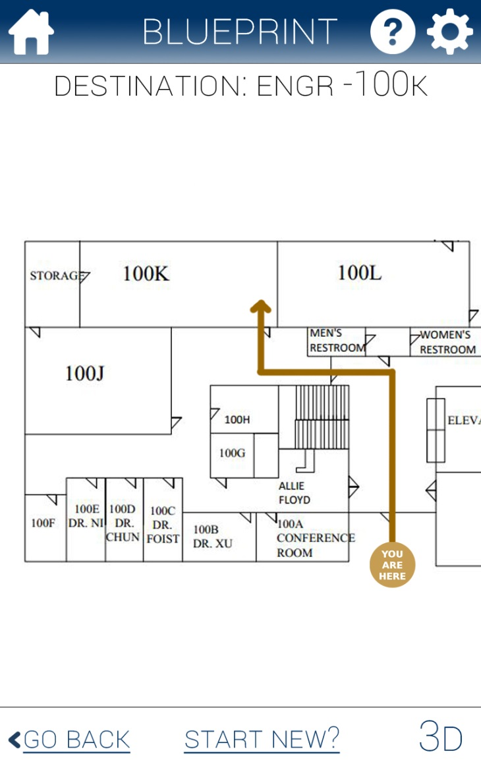
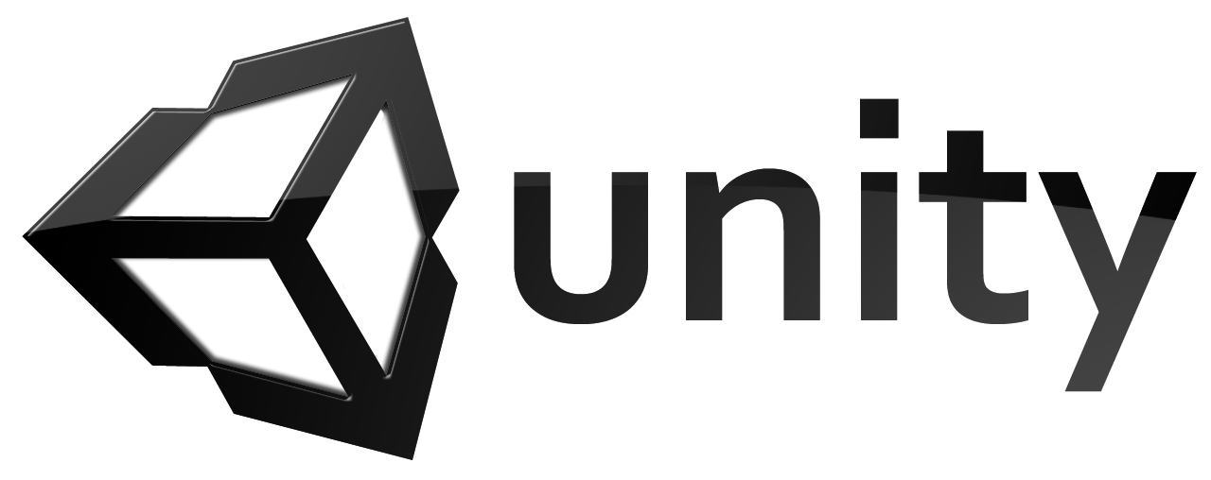


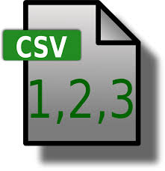
Blueprint is designed using Augmented Reality to help students find their classrooms.
Sponsor Logo
Jeremy Fischer, Justus Karenzi, Sudi Nsengiyumva, Jordan Ziegler, Dylan Shanahan
Electrical and Computer Engineering Department
California Baptist University: College of Engineering
Introduction
The purpose of this project was to design a mobile application to help students and visitors navigate to specific rooms in the CBU College of Engineering building. This program was developed for Android devices, and uses Augmented Reality technology in order to locate the desired destination. Figure 1 below shows how the program looks running on a device.
Software Design
The application was developed using Android Studio integrated with Unity. Android Studio was used to create the GUI (Graphical User Interface), and to design the overall structure of the application. We used a program called Unity, integrated with Android studio, to perform image recognition and to provide directions for the student. The directions are implemented using a CSV (comma separated values) file acting as the local database. In Figure 2 below it shows the flow of the User Interface of the application.
Building selection
Room selection
Scanning Area
Augmented Arrow
Directions
Figure 1. Application home page
shown on device (Google Nexus 7).
Background
The main goal of this project was to design a mobile application that made it easier for students to find their classrooms. By using an application with Augmented Reality technology, they are able to use their mobile devices to guide them to their destination inside the building. The application works similarly to how the navigation works in a persons car. The application is able to recognize the student’s surroundings using the device’s camera, and overlay the direction onto the screen. This will result in an interactive application that students can use to conveniently navigate to their next class without having to use a map or directory.
Figure 2. User Interface flow diagram.
Conclusion
Overall this project was very rewarding. It taught us how to integrate different types of software and programming in order to develop a fully functioning model. After debate and discussion, we were able to collaborate and decide the best way to develop this application. Through the Capstone design process we were able to understand how engineering projects work, and how they can be optimized for consumer use.
2D Map Layout
Acknowledgments
We would like to thank our Advisor, Professor Renck for his guidance in Android programming.
We would like to thank our Client Dr. Gordon for giving us the project and providing us with insight on how to application should be developed.
We would like to thank our professor Dr. Xu for helping us throughout the Capstone design process.

